Slide 1
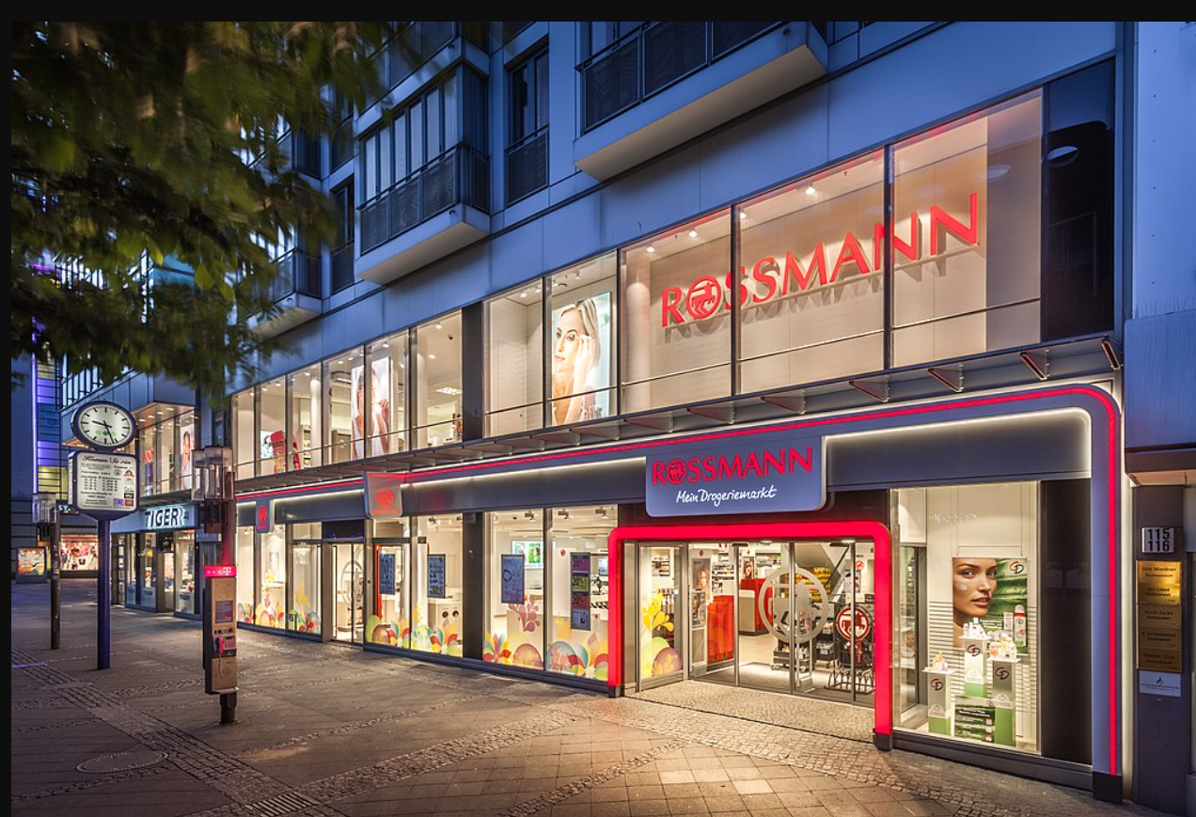
Retail-Sales-Prediction

Slide 2
Business Problem.
Rossmann operates over 3,000 drug stores in 7 European countries. Currently, Rossmann store managers are tasked with predicting their daily sales up to six weeks in advance. Store sales are influenced by many factors, including promotions, competition, school and state holidays, seasonality, and locality. With thousands of individual managers predicting sales based on their unique circumstances, the accuracy of results can be quite varied. My work includes various plots and graphs, visualizations , feature engineering, ensemble techniques, different ML algorithms with their respective parameter tuning , analysis and trends . Predictions are of 6 weeks of daily sales for 1,115 stores located across Germany.

Slide 3
Solution Strategy
My strategy to solve this challenge was:
Data Description: Use statistics metrics to identify data distributions.
Feature Engineering: Derive new attributes based on the original variables to better describe the phenomenon that will be modeled.
Exploratory Data Analysis: Explore the data to find insights and better understand the impact of variables on model learning.
Feature Selection: Selection of the most significant attributes for training the model.
Machine Learning Modelling: Machine Learning model training.
Hyperparameter Fine Tunning: choose the best values for each of the parameters of the model selected from the previous step.
Convert Model Performance to Business Values: Convert the performance of the Machine Learning model into a business result.

Slide 4
Conclusion
Achieved MAPE of 5.65% and MAE = $376 showing predictions of model is higly accurate for the sales forecast. Generated insights by EDA and feature importance provide valuable tools to decide the amount of budget and inventory for upcoming sales.

Slide 5
